Slide 1
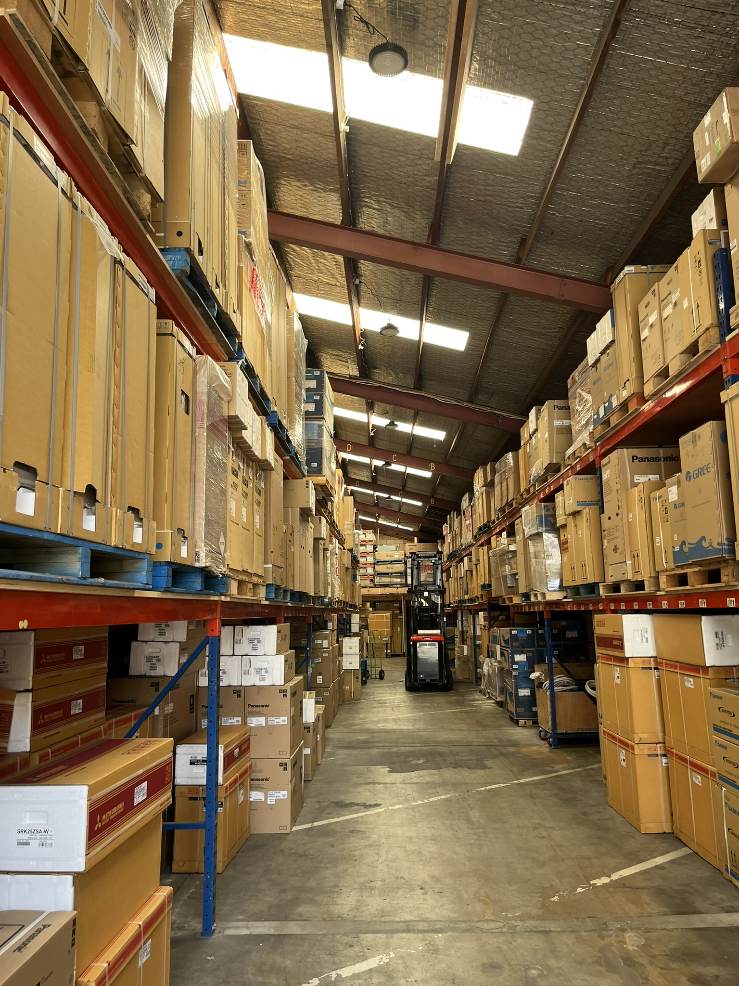

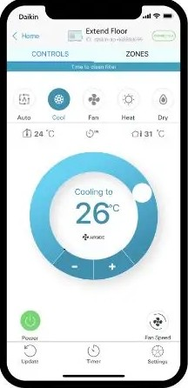
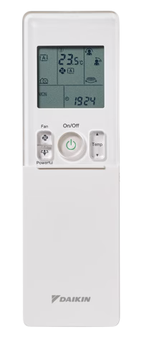


Standard Series
Installation Included
CU-Z80XKR
Cooling: 8.0kW
Heating: 9.0kW

Slide 2

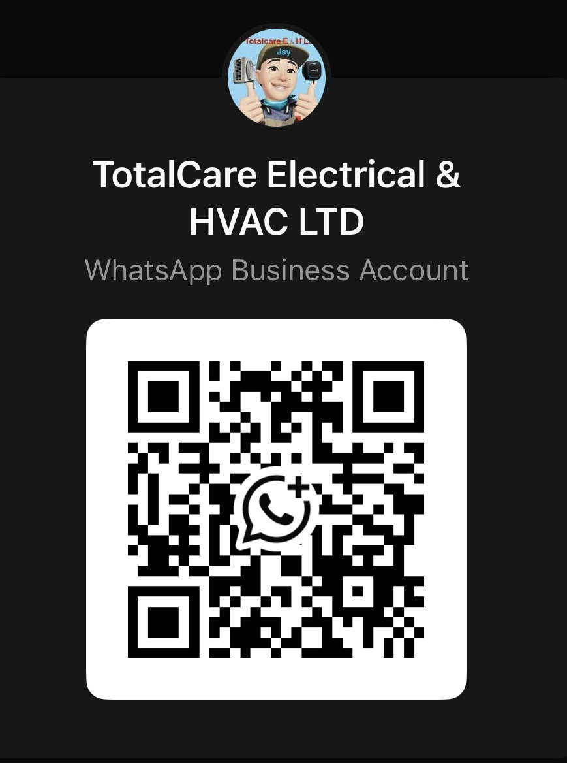
Open camera and scan this QR code for inquiry or
Call Now
0277 500 999

